Slide 1
INCA Meeting for Members – 23 March 2017
INCA Meeting for Members
23 March 2017

Slide 2
INCA Meeting for Members – 23 March 2017
Industry Update 2017
Welcome & Introduction
Katie Nurcombe
INCA
Notes:
Welcome everyone to this meeting for INCA members – great to see so many of you here
Key meeting today following the announcement of the proposed changes to ECO and I’m really pleased that Siobhan Stanger from DECC has joined us
We also have a really interesting session planned for after the coffee break where we want to hear your views on what INCA should be doing to help your business in 2014

Slide 3
INCA Meeting for Members – 23 March 2017
Market Intelligence
Overview of Current Market Conditions
Fiona Geskes
CBI
Notes:
Welcome everyone to this meeting for INCA members – great to see so many of you here
Key meeting today following the announcement of the proposed changes to ECO and I’m really pleased that Siobhan Stanger from DECC has joined us
We also have a really interesting session planned for after the coffee break where we want to hear your views on what INCA should be doing to help your business in 2014

Slide 4

OVERVIEW OF MARKET CONDITIONS
FIONA GESKES, CBI
THURSDAY 23 MARCH 2017

Slide 5

The economy has been resilient, post-Brexit
1.5
UK GDP growth (q/q%)
Growth has held up well since the referendum: at 0.6% in both Q3 and Q4 it far outpaced expectations.
Average growth
1.0
since 2013
0.5
Our growth indicator has softened a little since the end of last year and we expect growth to slow further in the coming quarters.
0.0
-0.5
Domestic demand will be more subdued. Investment intentions have cooled since mid- 2016 and growth in real household income is showing signs of softening as employment flattens out and inflation creeps up.
-1.0
-1.5
-2.0
But net trade should support growth: the weaker pound already appears to be feeding through to stronger export orders.
-2.5
Overall, GDP growth is expected to slow from 2% in 2016 to around 1½% in 2017 and around 1%
Source: Haver Analytics
in 2018.
2

Slide 6
Economy retains momentum going into 2017
CBI surveys: output growth (composite indicator; % balance)
40
Economic growth remained resilient in Q4, with GDP rising by 0.6% q/q, the same as Q3.
Q4 growth was driven by services (0.8%), especially consumer-facing sectors such as distribution, hospitality & travel.
Manufacturing returned to growth (0.7%), but output in construction was flat.
CBI’s growth indicator shows UK private sector activity eased at the start of 2017, but remained solid.
Growth expectations for the next 3-months remained also held up, with a positive outlook for manufacturing in particular.
This suggests the economy retains some momentum at the start of 2017, but we still expect growth to slow through the year.
3
Past 3 mths
Next 3 mths
30
20
10
0
-10
-20
-30

Slide 7




Uncertainty around the outlook has risen
Private sector domestic demand stronger than expected: renewed confidence in the UK
spurs business investment, and near-term strength in household spending is maintained
Lower pound supports exports and FDI
Slower pace of fiscal consolidation lifts confidence and activity
Financial market volatility weighs on credit availability and cost; hampers strategic decision- making; currency volatility limits scope for sustained exports boost
Financial strains in the Eurozone rear their heads: sparked by renewed fears around Italy’s banking system, and a number of upcoming elections over 2017
EU negotiations appear to go badly, increasing the risk of significant barriers to trade, capital and skills
Global growth momentum disappoints/risks manifest (eg, shift to more protectionist trade
policies in the US)
Inflation rises more than expected
Productivity more sluggish than expected, particularly with uncertainty having risen and business investment set to weaken
4

Slide 8
CONSTRUCTION PRIORITIES

Slide 9

The construction sector is closely linked to the overall health of the economy.
In Making a success of Brexit, the CBI took a cross sectoral view on the key priorities. For construction, these priorities are:
EU Trade: A large percentage of construction materials are imported from the EU so a tariff-free relationship is important
Regulation: Opportunities for a more flexible regulation must be balanced against the benefits of harmonisation
Migration: Access to EU skills and labour is important to the construction sector, as is the domestic skills programme
Funding: Long-term funding for infrastructure must not be interrupted by leaving the EU
Latest CBI EU report – “Making a success of Brexit”
6

Slide 10

Fiona Geskes
Sector adviser – construction, CBI
CONTACT US
e: fiona.geskes@cbi.org.uk t: +44 (0)7469 155 269
linkedin.com/company/cbi
@CBItweets
www.cbi.org.uk

Slide 11
INCA Meeting for Members – 23 March 2017
Insulation Innovation
Product Research & Development
Daniel Mack
Kingspan
Notes:
Welcome everyone to this meeting for INCA members – great to see so many of you here
Key meeting today following the announcement of the proposed changes to ECO and I’m really pleased that Siobhan Stanger from DECC has joined us
We also have a really interesting session planned for after the coffee break where we want to hear your views on what INCA should be doing to help your business in 2014

Slide 12
High Performance Insulation
Daniel Mack
23/03/2017
Notes:
Introduction and welcome
Who you are
Kingspan Insulation (Part of Kingspan Group)
Sites in Pembridge and Selby
Products / brands we make
What you will cover in this presentation – high (and premium insulation). Technical considerations to be made when choosing insulation for EWI and Rainscreen applications. In particular focus on importance of lambda and thin solutions

Slide 13
Agenda
The status quo – lambda matters
The science – thermal conductivities
Path to the future – what’s next?
How to walk this path – new applications

Slide 14
Status Quo – Lambda Matters
Impacts of using or not using thin insulation:
Fewer deliveries to site
Useful building footprint improved with thin insulation
Window reveals and roof overhang
Cost impact on ancillary components / installation
Notes:
The reason lambda is so important is that the thicker the insulation the greater the impact on other aspects of the construction such as the depth of studs, joints or rafters and length of fixings and fastenings, the width of the walls and the loading on the roof. This has implications not only for space but also cost.
There are also implications for refurbishment, where space may be limited or weight could be an issue.
Finally, it is important to insulate our new buildings to the best level that is practical, helping to future proof them against both changes to regulations and increasing energy costs. Higher performing insulants with lower-lambda make it easier to achieve this.
Impacts of using or not using thin insulation:
Fewer deliveries to site as less material is needed.
Useful building footprint will be reduced by a significant amount if thin solutions are not used.
Window reveals and roof overhang – refurbishment can cause unforeseen costs if the insulation added is thicker than the original design of the building. This can mean that extra measures will have to be taken to accommodate the thicker walls, floors or roof.
Managing existing services (i.e. radiators, sockets, switches, skirting boards).
Continuity of insulation.
Cost impacts on ancillary components / installation (i.e. fixings, beading, excavations, foundations, disposal etc.).

Slide 15


Thickness Comparison
Thickness to achieve an R-value of 5.0 m^{2.}K/W
Rock Mineral Fibre
0.034 W/m.K
170 mm
0.022 W/m.K
110 mm
0.020 W/m.K
100 mm
K100 Range
0.018 W/m.K
90 mm
0.007 W/m.K
35 mm
Thicknesses are rounded up to the nearest 5 mm. These do not necessarily represent stocked thicknesses.
Notes:
Many people believe that the effectiveness of insulation can be measured purely by its thickness, but this is not the case. The thing to look for is the lambda, which is expressed in units of W/m.K.
The lower the lambda value, the less heat energy the material will transmit and therefore the better insulating quality of the product. So a comparison of lambda values between insulation materials is one of the most effective ways of determining their relative thermal efficiency. This is true not only between different types of insulation, but also between materials of the same type but from different manufacturers.
Finally, it is important to insulate our new buildings to the best level that is practical, helping to future proof them against both changes to regulations, and increasing energy costs. Higher performing insulants with lower-lambda make it easier to achieve this.
Achieving lower U-values requires the right levels of insulation

Slide 16
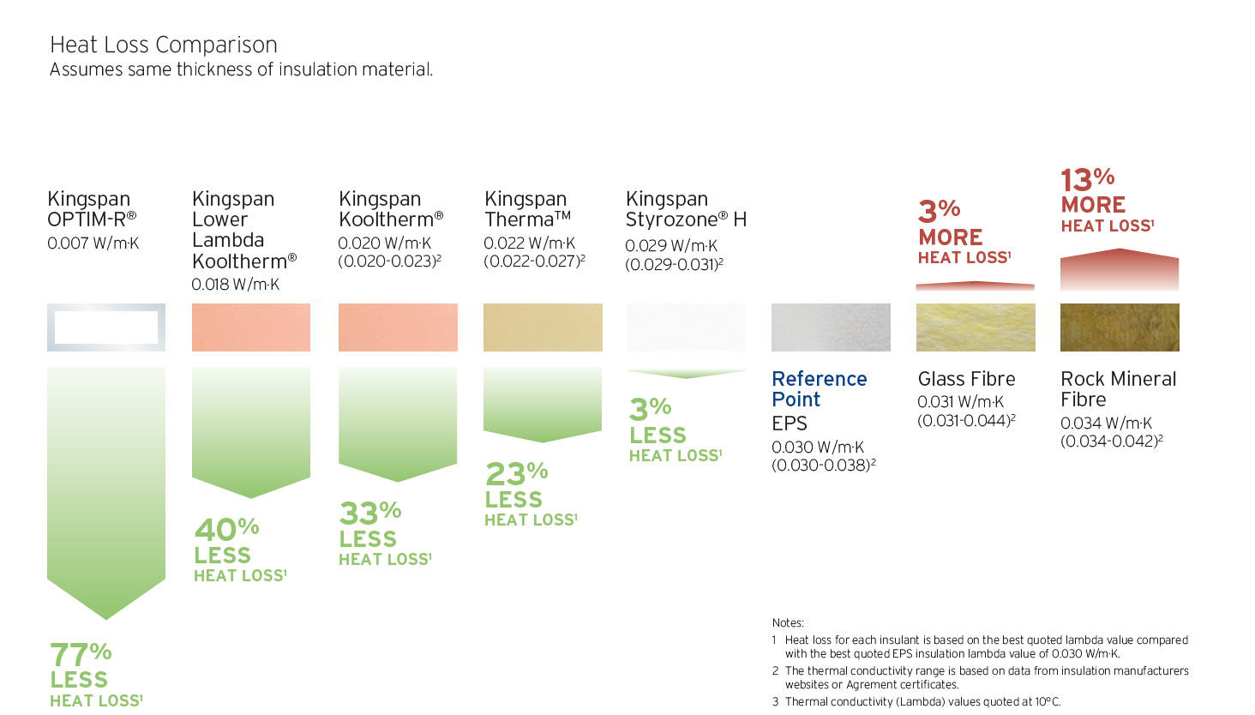
Heat Loss Comparison
Assumes same thickness of insulation material
Notes:
Another way to compare insulation is to consider the heat lost through the same thickness of insulation.
Kingspan offers a comprehensive range of premium and high performance products to cover every application, with minimal thickness, including:
OPTIM-R range of Vacuum Insulation Panels (VIPs) – (particular benefits: refurb & problem areas such as balconies, terraces etc.)
Kooltherm range of rigid Phenolic boards – (particular benefits: superior performance to any other rigid thermoset insulation board, so thinner)
Therma range of rigid PIR boards – (particular benefits: flat/tapered roof applications)
TEK Building System and Cladding Panel – Structural Insulated Panels (SIPs) – (particular benefits: speed of construction, PUR core, insulation continuity, low levels air permeability, reduced site waste)
KoolDuct - pre-insulated ductwork – (particular benefits: slim, lightweight, quick and easy to install, low air leakage)

Slide 17
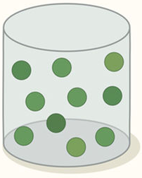
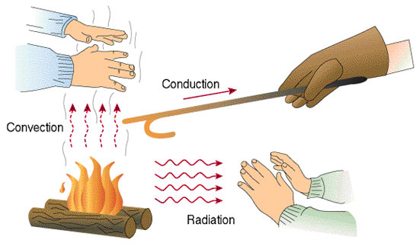

Thermal Conductivity
Heat Transfer
λ_{tot} = λ_{Gas} + λ_{Matrix} + λ_{Radiation}

Slide 18
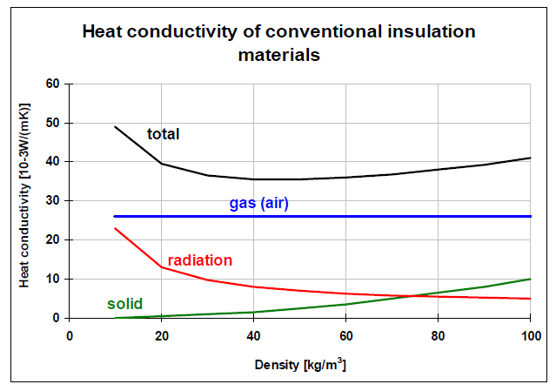
1st Generation Insulation
Mineral fibre, EPS, wood wool etc.
Limit: 25 W/m.K (air) + 3 mW/m.K (solid stage) + 2 mW/m.K (radiation)

Slide 19
2nd Generation Insulation
PIR and phenolic
Changing gases:
n-pentane 13.5 mW/m.K
c-pentane 11.1 mW/m.K
Air 25.4 mW/m.K
CO₂ 15.0 mW/m.K
CFC (not in use) 7.4 mW/m.K
Limit: 12 mW/m.K (pentane) + 4 mW/m.K (solid stage) + 4 mW/m.K (radiation)

Slide 20
3rd Generation Insulation
Vacuum insulation panels
λ_{tot} = λ_{Gas} + λ_{Matrix} + λ_{Radiation}
Limit: 0 mW/m.K (air) + 3 mW/m.K (solid stage) + 1 mW/m.K (radiation)

Slide 21

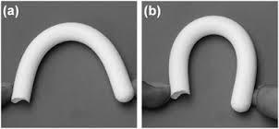
Another Way?
Aerogel
Usually: 30-45 mW/m.K. Silica- based: 14-16 mW/m.K
Best known: 12 mW/m.K

Slide 22
Comparison
Material | Pros | Cons
EPS & Mineral Wool | Cost, acoustics | Thickness
Foams | Thermal performance, usability | Acoustics
Aerogel | Thermal performance, moderate usability | Cost, lack of systems
VIPs | Excellent thermal performance | Cost, usability

Slide 23
Path to The Future
Lambda going down
Foam and VIP will lead the drive
Low lambda in more products & more application

Slide 24
How to Innovate ?
Process:
Stage gate process
Innovation as part of strategy
Joint development with key customers
KPI: vitality index

Slide 25
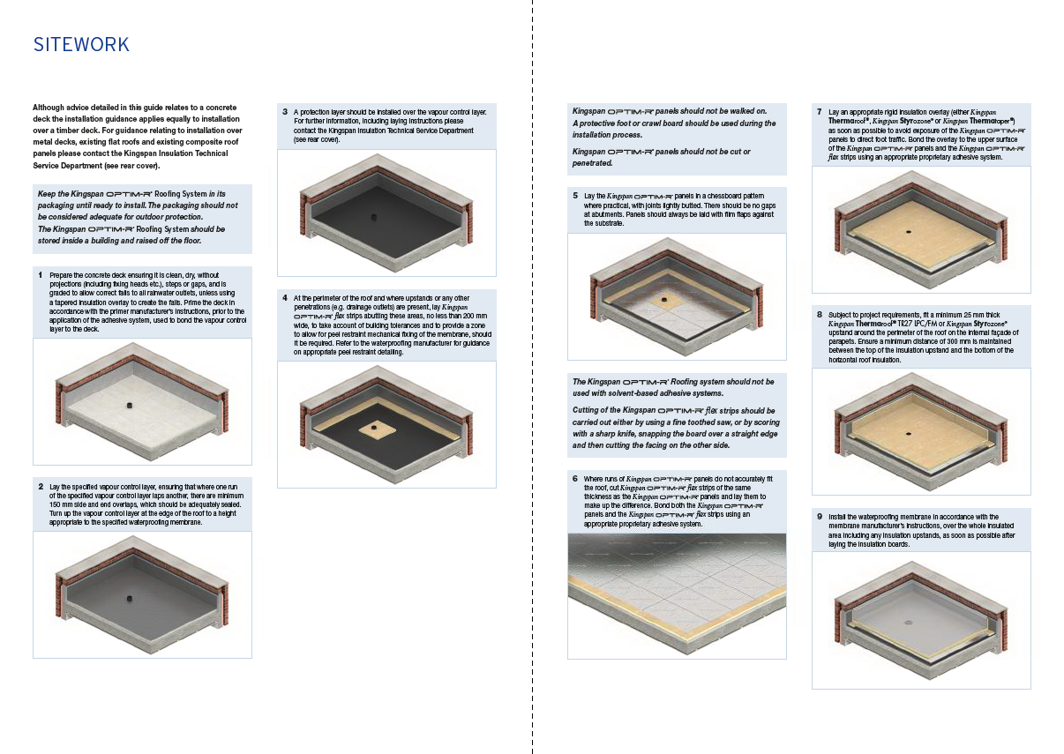
How to Innovate
Drivers for next decade:
Systems and simplification of installation

Slide 26
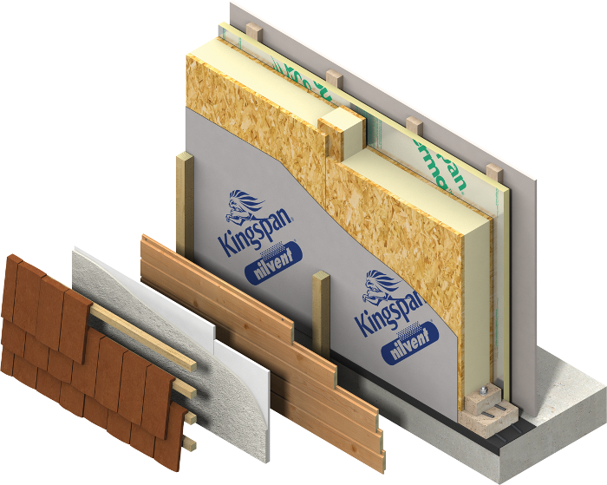
Structural Insulated Panels
Engineered timber system
TEK Cladding Panel
Notes:
SIP- for infilling the apertures in, or sheathing, the structural frame of a building
OSB and PUR – structural composite
Whole wall U-values of 0.20 W/m2.K or better
Low air leakage rates
Quick and safe to build
Internal works can start earlier
Minimal on-site waste

Slide 27
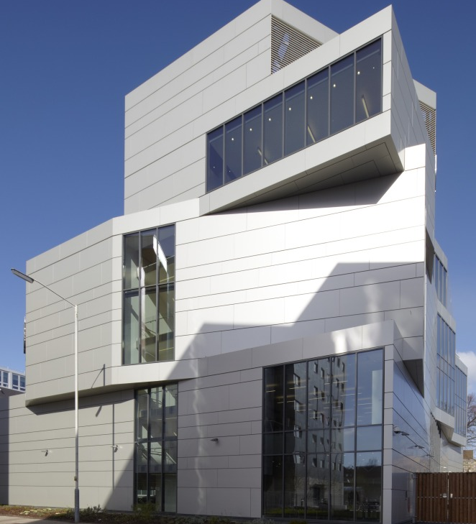
University of Bedfordshire, Luton
New build – rainscreen
External wall:
Kingspan TEK Cladding Panel & Kingspan Thermawall TW55
Notes:
TEK panels secured ‘out-board’ of the building’s structural frame in lengths of over 6 m (allowing them to span 2 floors)
This reduced lifting, accelerated construction process and minimised cold bridging.
Panels fixed using slotted fastenings to allow for the natural expansion and contraction of the concrete frame
Aim for BREEAM ‘Excellent’ rating
Final u-value of 0.15 W/m2.K

Slide 28
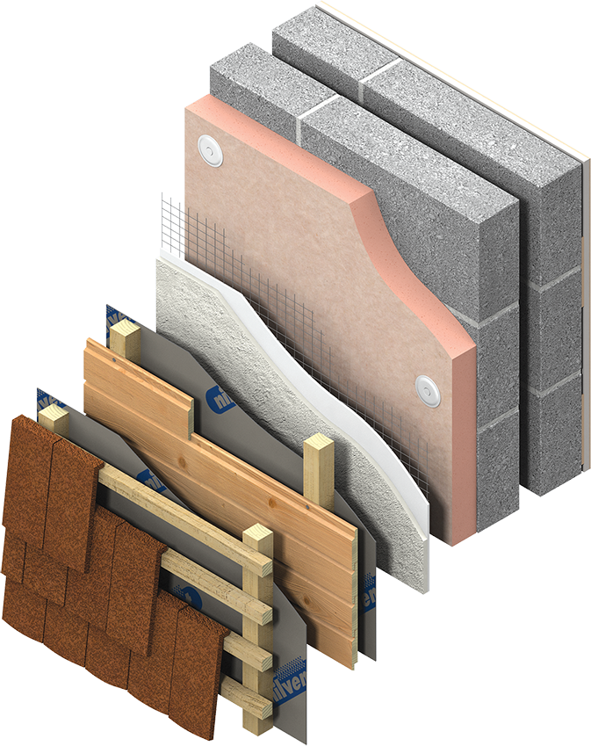
Phenolic Insulation
Premium Performance
Kooltherm K5 External Wall Board
Notes:
Kooltherm – premium performance phenolic
Lower lambda – 0.018 W/m.K
For EWI and Rainscreen – thermal conductivity as low as 0.020 W/m.K
Thinnest commonly used insulation board to achieve U-values
Fibre – free core
Safe and easy to install
K5
Similar advantages to OPTIM-R – fixings, daylight, eaves. Likely to be more cost effective to use a thinner, high performance insulation than to extend the eaves.

Slide 29
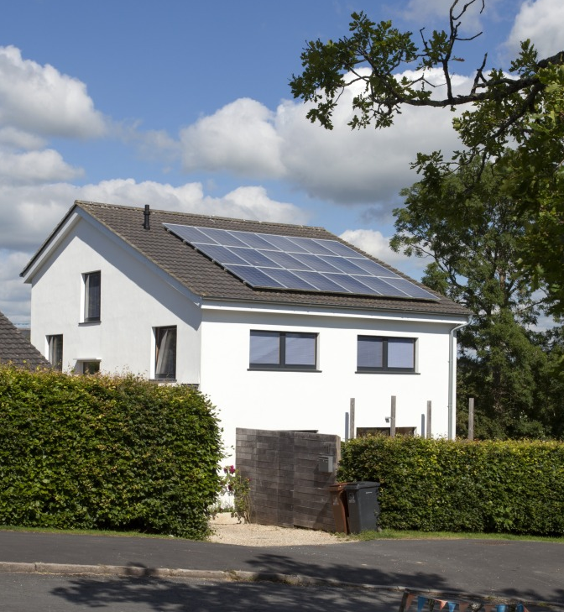
Totnes Passivhaus, Devon
Refurbishment - EWI
External wall:
Kingspan Kooltherm K5 External Wall Board
Floor:
Kingspan Kooltherm K3 Floorboard
Notes:
Originally built in 1960s
Tricky issue to overcome – the orientation of the dwelling and position on site could not be altered, therefore the thermal gain of the building was predetermined
Now certified to Passivhaus EnerPHit Standard
180 mm K5. Existing cavity filled with polystyrene bead.
Achieved wall U-value of 0.09 W/m2.K
Owner Adam Dadeby acted as the Passivhaus Consultant on the project. He commented:
“The architects and I specified the Kingspan Insulation products for the existing walls and floors because their thermal conductivity was lambda 90/90 CE Mark certified. Without this, we would have had to apply a 20% uplift to the manufacturer’s quoted lambda value.”

Slide 30
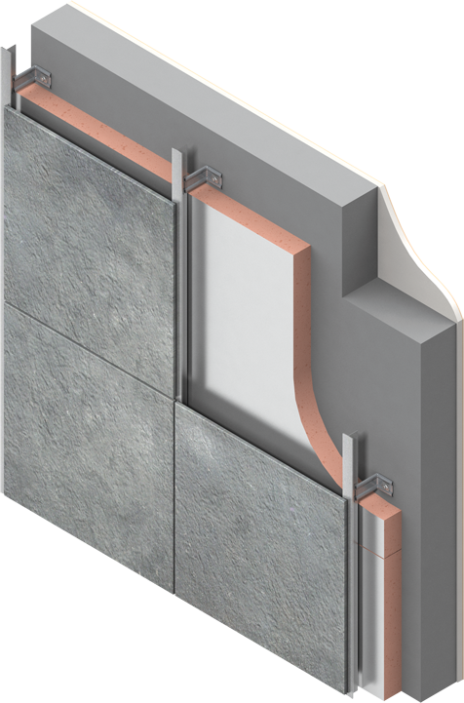
Phenolic Insulation
Premium Performance
Kooltherm K15 Rainscreen Board
Notes:
K15
First insulation board in rainscreen to achieve LABC Registered Detail status
Successfully tested in differing façade systems to BS 8414-1 and BS 8414-2, in accordance with performance criteria set out in BR 135
Great deal of work clarifying ‘routes to compliance’
RVOS

Slide 31
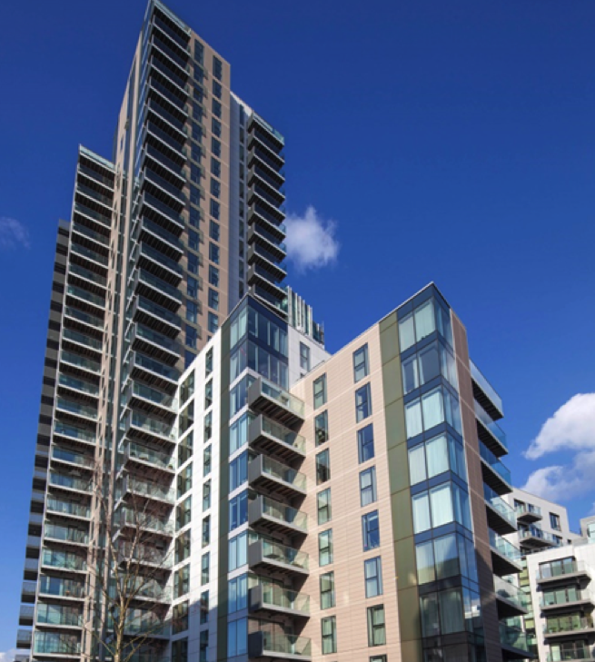
Woodberry Down, Manchester
New build – Steel frame & Rainscreen
Steel frame:
Kingspan Kooltherm K12 Framing Board
Rainscreen:
Kingspan Kooltherm K15 Rainscreen Board
Notes:
Woodberry Down was once heralded as the ‘estate of the future’ but in recent years had suffered from an increasing number of issues including: subsidence, asbestos, damp, and poor insulation. An eight phase regeneration plan will replace outdated concrete tower blocks with more than 5,500 brand new homes over the next 20 years. Architect Hawkins\Brown specified Kingspan Kooltherm K12 Framing Board and K15 Rainscreen Board for Kick Start Sites 2 and 5 within the master plan, comprising 710 residential units and over 1500 m² of commercial space, spread across a number of blocks.
Kingspan Kooltherm K15 Rainscreen Board was installed as part of the anodized rainscreen cladding used on the top storeys of many of the blocks. These sections extend beyond 18 metres and it was, therefore, essential that the product offered excellent fire performance. The board has been tested to BS 8414-1 and BS 8414-2, and successfully assessed in accordance performance criteria set out in BR 135, in a range of insulation thicknesses with a variety of cladding finishes. It is, therefore, acceptable for use above 18 metres in accordance with the Building Regulations / Standards in its tested configurations.
Kingspan Kooltherm K12 Framing Board was also installed within a steel framing system behind the main brickwork façade elements. The lightweight boards are easy to install and can be used with timber or steel frame constructions. Both products have been assigned 2008 Green Guide Summary Ratings of A+ by the BRE.
Useful Links:
http://kingspaninsulation.co.uk/Case-Studies/Woodberry-Down---London.aspx

Slide 32
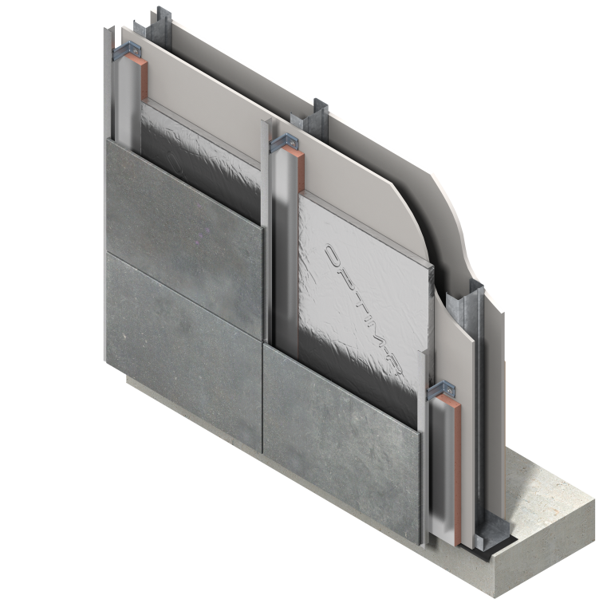
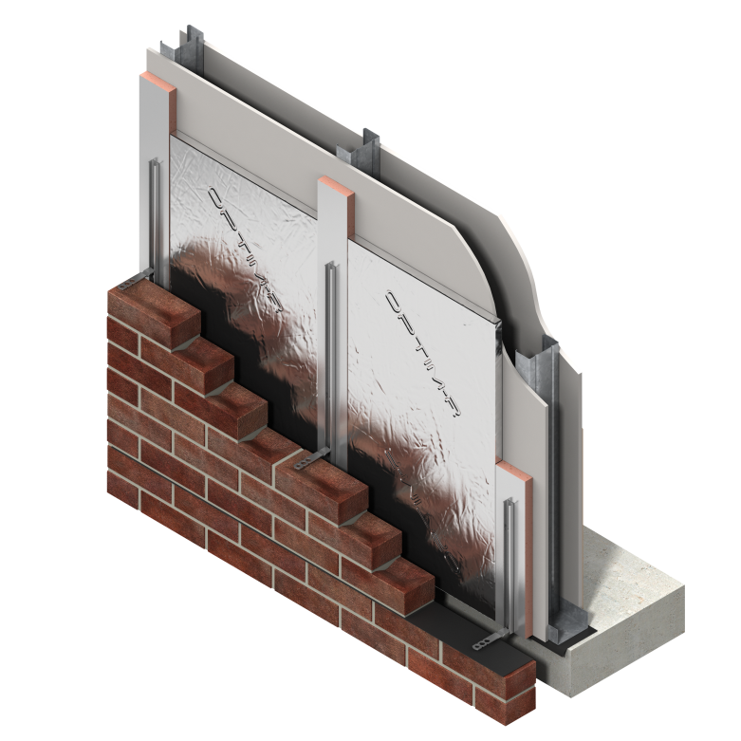
Vacuum Insulation Panels
Problem solvers
OPTIM-R Rainscreen Board
OPTIM-R External Wall System
Notes:
Now we will go through some options to illustrate the uses for different insulants and how their lambda impacts on their utility.
OPTIM-R – next generation insulation.
Where there is a requirement for both low U-values (regulatory requirements, refurbishment) and the thinnest possible wall build-up.
Already high performance materials available – however vacuum insulated panels are for use where an even thinner product is needed.
Lambda of 0.007 – thermal peformance up to five times better than commonly used insulation
Fix (to fix through) and flex (as infill) strips – phenolic
Design service – maximise use of VIPs
Rainscreen considerations – extending eaves, longer and more costly fixings, trims and accessories, reduction of daylight.
EWI considerations – depth of eaves overhangs, encroachment into access routes, creation of unsightly steps between adjacent insulated and uninsulated wall, longer and more costly fixings, reduction of daylight.
Challenges - % of infill, installation (speed, damage to panels, educating the installer). Can mention what we have done (handling advice, toolbox talks).

Slide 33
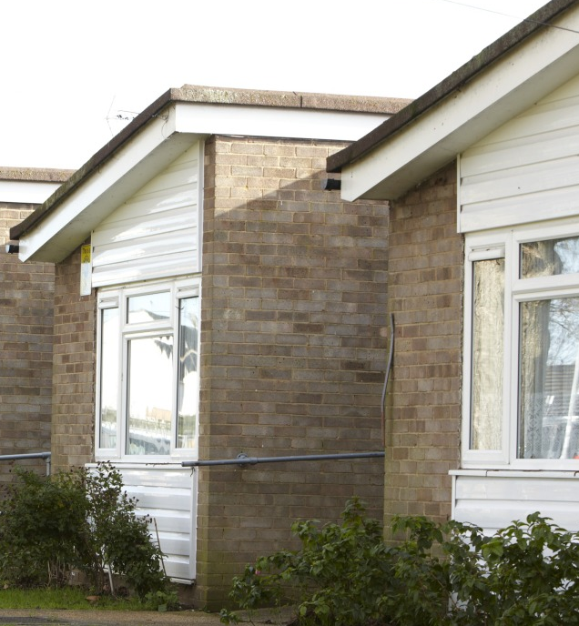
Pantile Avenue, Southend-on-Sea
Refurbishment - EWI
External wall:
Kingspan OPTIM-R External Wall System
Notes:
Refurbishment of 10 under-insulated bungalows
Minimal cavity space
Wanted to retain existing external finish but improve thermal efficiency of building envelope.
20 mm of OPTIM-R
Achieved U-value of 0.20 W/m2.K

Slide 34
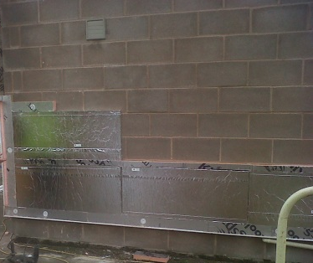
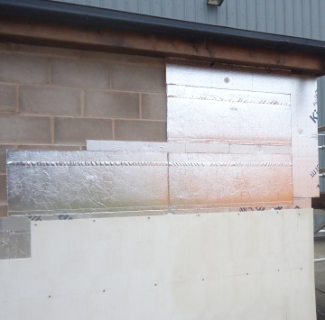
Test system

Slide 35
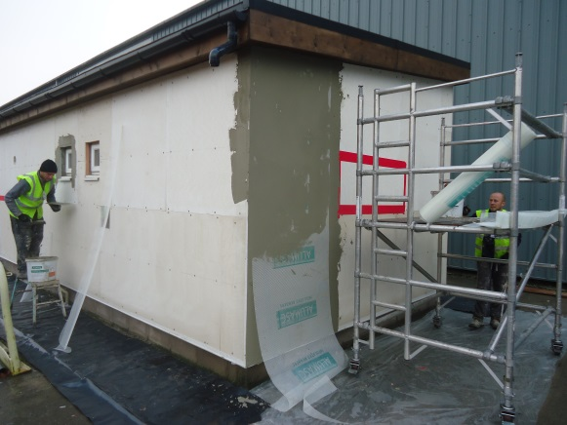
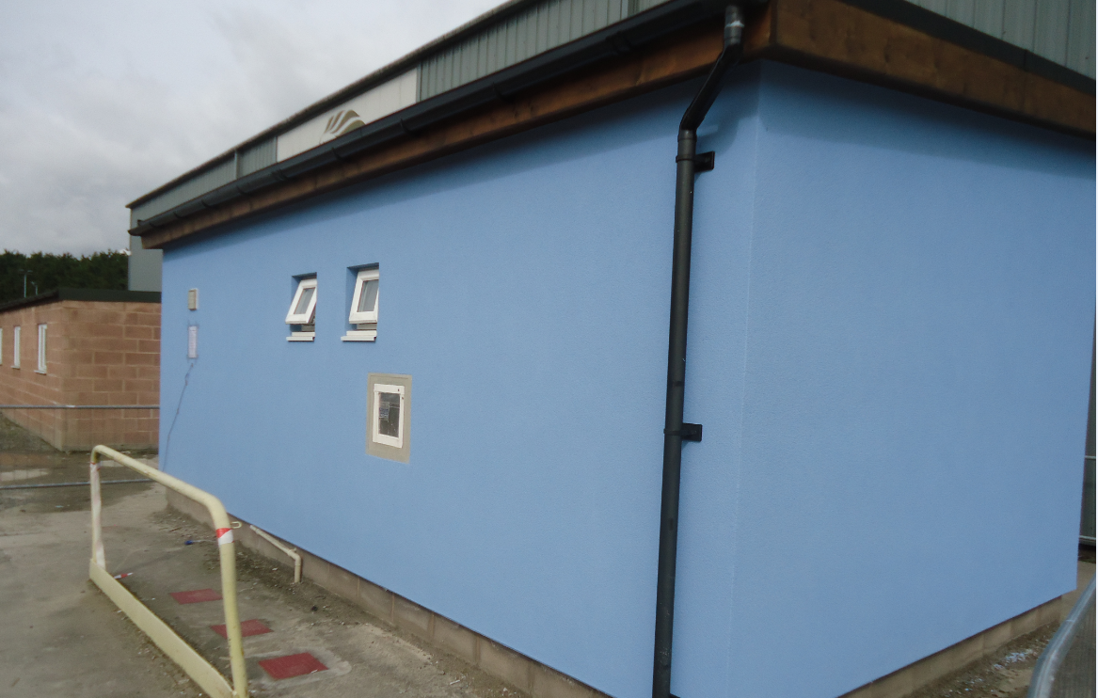
Test system

Slide 36
Summary
“Companies cannot grow through cost reduction and reengineering alone… Innovation is the key element in providing growth…”
Tony Davila – Making Innovation Work

Slide 37
Thank You

Slide 38
INCA Meeting for Members – 23 March 2017
Client Perspective - Landlords
Opportunities & Challenges
Matthew Oliver
NLA
Notes:
Welcome everyone to this meeting for INCA members – great to see so many of you here
Key meeting today following the announcement of the proposed changes to ECO and I’m really pleased that Siobhan Stanger from DECC has joined us
We also have a really interesting session planned for after the coffee break where we want to hear your views on what INCA should be doing to help your business in 2014

Slide 39
ENERGY EFFICIENCY IN THE PRIVATE RENTED SECTOR
Matthew Oliver - Policy & Public Affairs Executive
Insulated Render and Cladding Association
March 2017

Slide 40
Contents
Who are the NLA
Background
Obstacles to Improvements
Regulating the PRS
Financing Improvements
Engaging with Landlords

Slide 41
The National Landlords Association
The UK’s leading representative organisation for private residential landlords
  Working with 76,000 landlords, including 35,000 paying members
  Providing information, advice and services to support their businesses
  Campaigning to influence policy and to make the landlords’ voice heard
  Working to raise standards in the private rented sector and ensure landlords are aware of their rights and responsibilities

Slide 42
20% of Dwellings…
English Housing Survey 2015-16
Notes:
PRS is fastest growing sector in the UK.
In England almost 20% of dwellings are in the PRS
UK wide:
2001 – 2.3million households
Today – 5.4million
Estimated 2025 – could rise to 7.2 million

Slide 43
PRS: More Older Stock …
Age of Housing Stock by Tenure
Source: English Housing Survey 2015-16
Notes:
Over half (50.1%) of privately rented housing stock was built before 1945
and the PRS contains a greater proportion (34%) of pre-1919 properties than any other tenure

Slide 44
… And Poorer Energy Performance …
Energy Performance of Private Sector Dwellings (%)
Source: English Housing Survey 2015-16
Notes:
6.3% of PRS properties (over 300,000) have an EPC rating of F or G
5.2% of owner occupied
0.9% in social sector

Slide 45
…which varies across the country…
Source: DBEIS
Notes:
Breakdown of where the F&G rated properties are: 14.4% of them are in East of England.

Slide 46
Means More Opportunities to Upgrade
Source: English Housing Survey 2015-16
Notes:
Lowest percentage of cavity wall properties with insulation
Lowest percentage of solid wall properties with insulation

Slide 47
Obstacles to improvements
  Lack of available funding
  Energy Efficiency Schemes not effective in multi-occupancy buildings
  Funding incorrectly targeted at occupiers rather than owners
  Locating eligible occupants was extremely difficult
  Failure of the Green Deal
Notes:
1,074,951 72.8
212,168 14.4 % - PRS ECO measures since Jan 2013
188,881 12.8
Changes to ECO in 2017:
Refocus to target the fuel poor more
Inclusion of social rented properties rated F&G
***Green Deal = first energy efficiency programme in over 20 years that understood how landlords worked – ‘tackled split incentive’

Slide 48
The ‘split incentive’ & No Imperative
  Landlords pay for the improvements
  Tenants benefit from reduced fuel bills and warmer homes
  Landlords unlikely to recoup their costs
  The demand is there – no market necessity
  Tenants are seemingly not too fussed

Slide 49
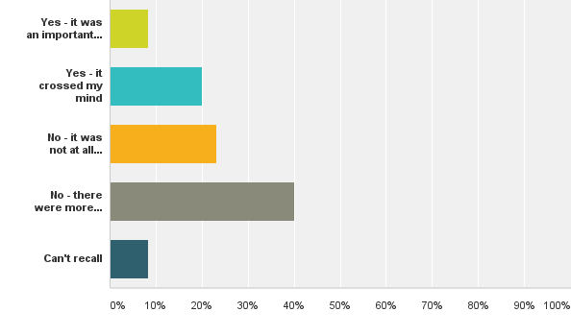
Did you consider the energy efficiency of your home when deciding to live there?
Notes:
NLA Private Tenant Survey December 2016
541
Answer Choices–
Responses–
–Yes - it was an important factor = 8.36%
–Yes - it crossed my mind = 20.06%
–No - it was not at all important = 23.12%
–No - there were more important factors = 40.11%
–Can't recall = 8.36%
Total359

Slide 50
Regulating the PRS
3 stage implementation of standards
April 2016 – Tenants’ Right to Request
April 2018 – Ban on new tenancies (F&G)
April 2020 – Ban on all tenancies (F&G)
Notes:
Minimum Energy Efficiency Standards passed in 2015, stemming from the Energy Act 2011
In a nutshell:
Tenants’ now have the right to request consent to make energy efficiency improvements
Landlords cannot “unreasonably refuse” consent
Landlords will not be allowed to create new tenancies for properties rated F&G, unless they register a valid exemption
No tenancies will be allowed for any properties with an EPC rating of F or G, unless a valid exemption is registered
From today (April 1st), where a tenant requests their landlord’s consent to make energy efficiency improvements, the landlord may not unreasonably refuse consent.
This is part of the drive to make the PRS more energy efficient, and is the precursor to regulations dictating an EPC minimum rating of E for new tenancies (2018) and for all tenancies (2020).
This is a quick guide that covers your new obligations and responsibilities.
No Upfront Costs
Before we go through the request process, it is important to note that landlords are not required to contribute funding for any energy efficiency measures requested by the tenants.
It is the sole responsibility of the tenant making the request to organise funding, and tenants should ensure that suitable funding is available before they make a request.
We successfully lobbied the Government to ensure that there are no upfront costs for landlords. A landlord can choose to fund or part-fund efficiency improvements, but this is entirely at their discretion.
Submitting a Request
Before submitting a request, the tenant must first identify what improvements they want to make (from a list of approved measures) as well as the necessary funding for those improvements. This funding may come from:
The Energy Company Obligation (ECO)
Central Government or local authority funding, or third party funding such as a grant,
A Green Deal Finance Plan (or future equivalent as the Green Deal is currently closed)
Tenant funding where they pay the upfront costs themselves (either fully or in combination with another source of funding above).
A tenants’ request for improvements is not valid without these two things.
Once/if these have been identified, then the request must be made to the landlord in writing with the relevant information.
Responding to a Request
First, you should check that the request is a valid one (as described above). You must respond in writing within one month, either confirming your consent to some/all of the measures requested or providing reasons for your refusal.
You may also offer a counter-proposal to the tenant regarding energy efficiency improvements, but an initial response to the tenants’ request must still be given in writing within a month and it must state that you intend to provide a counter proposal.
You will be under a statutory duty not to “unreasonably refuse consent”, so if the request is valid there are only certain grounds on which consent can be refused:
Previous request from any tenant in same property within the last six months that has been dealt with
Relevant HHSRS notice on the property
Expert advises improvement may damage fabric or structure of the property (for wall insulation request only)
Tenant refused consent for same improvements within the last six months
Third party consent is required for the requested improvements but this consent cannot be obtained (e.g. planning permission or consent from mortgage lender)
The improvements will result in a reduction of the market value of the property of more than 5%
After Refusal
If you have a refused consent for some or all of the tenants’ requested improvements, it is then up to the tenant to consider your response.
If they are not content with your response and believe you have unreasonably refused consent then the tenant can apply for the First-Tier Tribunal to consider the application.
The Tribunal can then decide that the landlord must give consent, or rejects the tenants appeal.

Slide 51

Toothless?
Regulations heavily tied to the Green Deal
“No upfront costs” exemption wide-ranging
Notes:
Designed around the Green Deal Golden Rule. With no Green Deal finance currently available, the regulations as they stand would exempt most landlords.
Currently provides a five-year exemption for landlords where they are unable to undertake improvements without up-front cost—specifically where measures cannot be wholly financed, at no cost to the landlord, using funding from central Government, a local authority or any other source.
It is unlikely that landlords will be able to access sufficient support through ECO or other sources.
1,074,951 72.8 % - Owner Occupied
212,168 14.4 % - PRS ECO measures since Jan 2013
188,881 12.8% - in social rented sector
Changes to ECO in 2017:
Refocus to target the fuel poor more
Inclusion of social rented properties rated F&G

Slide 52
Putting the bite back into it
New Government – New Plan?
Consulting sector on giving the regulations teeth
Introduce financial imperative:
  Ditch the “no upfront cost” exemption
  Introduce a cap on the cost - £5000
Notes:
Delayed implementation of the exemptions register for landlords by a year, no access until 1st October 2017
This was so they could come up with a solution to cost-effectiveness problem caused by the failure of the Green Deal

Slide 53
Putting the bite back into it
NLA propose that the cost cap set at an initial level of £3,500 per property
Estimated cost to improve
  75% of F and G-rated to EPC band E.
  74% of E, F & G rated properties reach a D rating.
Source Energy Saving Trust

Slide 54
Financing improvements
Changes to ECO
  Expanding eligibility to E, F & G rated social rented properties could pull investment away
  “Flexible eligibility” – local authorities given power to deem property eligible
Notes:
The Energy Company Obligation (ECO) is an energy efficiency programme introduced into Great Britain at the start of 2013, which places legal obligations on the larger energy suppliers to deliver energy efficiency measures to homes to reduce carbon emissions and tackle fuel poverty. – https://www.ofgem.gov.uk/environmental-programmes/energy-companies-obligation-eco.

Slide 55
Renewal of Green Deal Financing?
Green Deal loan company bought
Looking to offer new loans in 2017
Same Golden Deal basis
Notes:
Greenstone Finance and Aurium Capital Markets acquire the Green Deal Finance Company (“GDFC”)
LONDON, 15 January 2017: Greenstone Finance and Aurium Capital Markets (“Aurium”) have today announced the acquisition of the business and assets of the Green Deal Finance Company (“GDFC”), as well as its existing loan book with a principal value in excess of £40m; the acquisition is being supported by Honeycomb Investment Trust (“HIT”) which is managed by Pollen Street Capital.
Greenstone Finance, which invests in organisations focused on financing in renewable energy and energy efficiency, and Aurium, a structured finance boutique with a focus on renewable energy, have acquired GDFC Services and its subsidiaries with immediate effect; the new ownership will continue to service the existing Green Deal loans and will commence financing of new Green Deal loans in Q1, 2017.
First launched by the Government in 2013, the Green Deal was established to address the fact that the UK has some of the most thermally inefficient housing in Europe. Green Deal loans provide customers with accessible financing to improve their homes by installing energy efficiency products. In particular, Green Deal financing has the potential to help:
those who face the heavy costs of needing to install a new boiler or other essential measures but who can’t afford to pay the upfront costs of doing so;
those who want to increase the value of their homes through installing renewable energy or energy efficiency measures;
landlords requested by tenants to install energy efficiency improvements or, as of April 2018, landlords who own properties that fall below the new minimum energy efficiency (EPC) rating of E;
Green Deal loans not only offer competitive interest rates, but are more easily managed as loans are repaid as part of a customer’s energy bill, which will normally be reduced by the energy savings generated from the measure the loan has financed – a “Pay-As-You-Save” scheme. Furthermore, the loan remains with the property and is paid by the energy bill payer from time to time – ensuring the payments are made by the person who benefits from the energy saving.
Minister for Energy and Industry, Jesse Norman, said,
"People living in more energy efficient homes can have lower bills and warmer homes, while producing fewer carbon emissions, which is why the Government has committed to improving the insulation of more than one million homes over this Parliament. This deal will help us to reach that goal."
Kilian Pender, Founder and CEO of Greenstone Finance, said,
"We believe that the concept of repaying your loan as you save on your energy bills is an excellent one and with the significant private investment that we have secured, we’re looking forward to rolling the Green Deal finance scheme out across the country. We will provide homeowners a cost-effective way to improve their homes and quality of life."
Nimesh Kamath, Partner at Aurium, said,
"This joint venture with Greenstone Finance adds to Aurium’s continued commitment to the UK renewable energy sector and, in particular, the objective of improving the energy efficiency of UK buildings for consumers and business owners alike, whilst supporting the wider goals of distributed energy generation and energy security in the UK."
NOTES TO EDITORS
Media enquiries
For all media enquiries please contact:John Evans, Hawthorn Advisors:
j.evans@hawthornadvisors.com 0203 745 3819 ¦ 07881 917184
Rose Schreiber, Hawthorn Advisors
r.schreiber@hawthornadvisors.com 0203 745 3819 ¦07854 429 301
About Greenstone Finance
Greenstone Finance was set up by Kilian Pender in August 2015. Greenstone Finance is a holding company which invests in and starts companies focused on the financing space in renewable energy and energy efficiency. Greenstone Finance aims to become the leading finance provider to UK homeowners, landlords and SMEs wishing to save money and improve their properties through energy efficiency products. Greenstone Finance is a private company backed by a consortium of investors.
About Aurium Capital Markets
Aurium is an award winning, leading mid-market investment house, providing its investors with access to innovative opportunities across several asset classes, most notably renewable energy and real estate. Aurium specialises in managing risk without compromising yields and is able to finance transactions where size, complexity, knowledge or speed of decision-making are crucial to achieving above market returns without compromising asset security.
About the Green Deal
The Green Deal was a UK Government scheme launched in 2013 set up to reduce the greenhouse gases emitted by the UK’s residential housing stock, which currently accounts for around 25% of the UK’s energy demand and 12% of the UK’s greenhouse gas emissions, as part of national efforts to meet the UK’s legally binding target to reduce carbon emissions by at least 80% by 2050.
Green Deal finance is a highly attractive offer because it allows consumers to meet the upfront costs of installing energy efficiency measures by providing a fixed interest rate over the lifetime of the finance plan. The key feature of the finance scheme is that the repayment of the loan is made with the customer’s energy bill and so can be managed more easily as the bills should be lower as a result of the energy savings made from the installation of the measure. In addition, Green Deal loan repayments are attached to the property, not the individual, and this means consumers can make the energy efficiency improvements without having to worry that they will be left with a loan to repay if they leave the property.
In terms of immediate priorities, Greenstone Finance will focus on improving access to and awareness of Green Deal finance by investing significantly into its website, customer services and training of Green Deal Providers. Following the departure of the GDFC team, Greenstone Finance has assembled a new management team to run the business and operations for the Green Deal Finance Company.
About Green Deal Finance Company Ltd
The Green Deal Finance Company Ltd is a not-for- profit company which was established to support the Government’s Green Deal programme by setting up, financing and administering Green Deal Loans, entered into by Green Deal Providers with consumers. This allowed Green Deal Providers to sell more energy efficient products, whilst not having to finance the loans that they originated. In July 2015 the Government said that it would provide no further funding for the Green Deal Finance Company Ltd to purchase any more Green Deal Loans and as such, the Green Deal Finance Company suspended financing Green Deal loans for Green Deal Providers. The Green Deal Finance Company Ltd currently has a loan book with a principal value in excess of £40m.
The acquisition by Greenstone Finance and Aurium pertains to the business, operations and assets belonging to the Green Deal Finance Company Ltd.

Slide 56
Engaging with the Sector
Appropriate messaging
  Landlords and tenants need different messages
  Landlords more likely to initiate works
  Private Rented Sector (PRS) Regulations will play large part
Understanding tenancy lifecycles
  Landlords will be more receptive at certain times of the year
  Targeting students during the summer will not work
Notes:
Although majority of tenants don’t take notice of energy efficiency when moving, two-thirds do want their landlord to make an improvement.
A warm tenant is a happy tenant, who is a longer term tenant!
Student landlords – more receptive to work in summer when property vacant

Slide 57
Engaging with the sector
Small scale delivery
  Most landlords own small portfolios which are often in several different areas
  Area based approaches and large scale delivery models will not work
Understanding Landlord Finances
  The £5k cap may cause funding issues to landlords
  Offer easy and innovative financing solutions
  Funding may become available**
Notes:
** Landlord Energy Saving Allowance
Return of a better (working) Green Deal?
Pay As You Save infrastructure still in place.

Slide 58
Skyline House, 2nd Floor
200 Union Street
London SE1 0LX
Tel: 020 7840 8900
Email: info@landlords.org.uk
Twitter: @nationalandlord

Slide 59
INCA Meeting for Members – 23 March 2017
Coffee

Slide 60
INCA Meeting for Members – 23 March 2017
BBA Focus & Priorities
Certification of EWI Systems
Brian Moore
BBA
Notes:
Welcome everyone to this meeting for INCA members – great to see so many of you here
Key meeting today following the announcement of the proposed changes to ECO and I’m really pleased that Siobhan Stanger from DECC has joined us
We also have a really interesting session planned for after the coffee break where we want to hear your views on what INCA should be doing to help your business in 2014

Slide 61
INCA Members’ Meeting
BBA Focus & Priorities
Brian Moore
Operations Director
23 March 2017

Slide 62
Certification of EWI Systems - chronology
A major EWI failure in early 2016
Alerted BBA to a potential issue with windload calculations
Requirement made of all EWI Certificate holders to provide an example in October 2016
Peer review of BBA methodology in December 2016 and
February 2017
Individual Certificate holders written to 28th February/1st March 2017
Summary of findings sent to Certificate holders 16th March 2017
Report and recommendations to be finalised 31st March 2017
Meeting with affected BBA Clients 25th April 2017

Slide 63
Summary of findings
At first submission, only a small minority found satisfactory
Wide variation in approaches
Expertise and experience not consistently available
Although accountability for design is vested in the Certificate holder, perceived lines of accountability not always felt to be clear between Certificate holder, external expert and installer
More likely than not that some installations may be at risk of failing prematurely

Slide 64
The Future: what lessons can we learn?
BBA is working now with each Certificate holder to help address individual issues identified in the review
Windload calculations will need to be scrutinised as part of
future surveillance
The case for pre-installation independent checks to be
considered again
Stricter regime of notifying failures

Slide 65
The Past: what lessons can we learn?
Where serious deficiencies have been identified in methodology, risk assessment should be undertaken
In a way that commands confidence and is affordable
Where issues are identified, proportionate steps taken to
address them

Slide 66
Issues to be considered and addressed
Undertaking risk assessments – Who should consider previous designs/installations where methodology flawed?
Communications – who needs to know about this?
Confidence – how will this best be achieved?
Financial implications – of risk assessment and any remediation?
Non-BBA certificated designers/installers – how to review their work?

Slide 67
Each Home Counts Review
‘Compliance and Enforcement’ strand:
Mapping the existing arrangements
Against what EHC proposes
Making the case for the difference
‘Whistleblowers’ – No prescribed body or person under the Public Interest Disclosure Act 1998

Slide 68




BBA Focus and Priorities
Local Authorities and Housing Associations – marketing campaign

Slide 69


BBA Focus and Priorities
New Company –
BBA Consultancy, Investigations and Training Ltd (CIT)
Office 4.1, Capital Tower Business Centre,
Capital Tower, Greyfriars Road,
Cardiff CF10 3AG

Slide 70

BBA Focus and Priorities
New Company -
BBA EU Certification Ltd based in Ireland

Slide 71
What are we doing for you in the year ahead?
Upholding confidence in the Certification process through:
Raising and challenging inadequate practice
Marketing the good work of Certificate holders to a vast range of public and private sector bodies
Ensuring that the UK remains attractive in Europe and beyond

Slide 72
Any questions?

Slide 73
Thank you

Slide 74
INCA Meeting for Members – 23 March 2017
PAS2030 Revision
Changes to PAS2030 Overview
Thermal Bridging Detail
Andrew Champ – SWIGA
Ben Edmonson – INCA
Notes:
Welcome everyone to this meeting for INCA members – great to see so many of you here
Key meeting today following the announcement of the proposed changes to ECO and I’m really pleased that Siobhan Stanger from DECC has joined us
We also have a really interesting session planned for after the coffee break where we want to hear your views on what INCA should be doing to help your business in 2014

Slide 75
INCA PAS 2030 /31 update
Andrew Champ: Executive Director SWIGA
www.swiga.co.uk

Slide 76
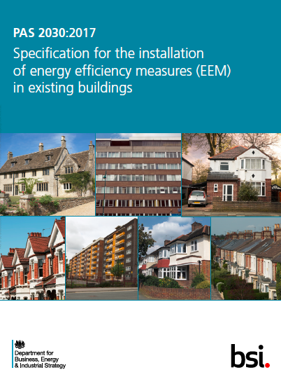

Context
PAS2030 focus on process
Little detailed installation guidance
Lack of design support
Inappropriate applications
Unintended consequences
Insufficient audits
Light touch accreditation
Backdrop of “more consistent installations”

Slide 77
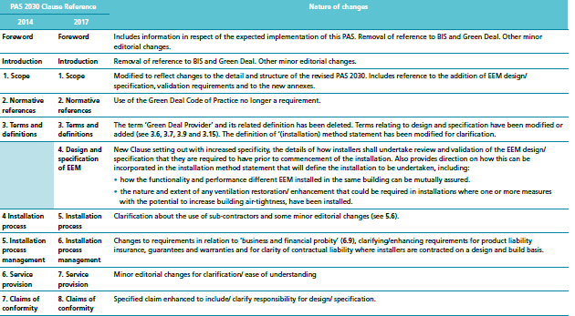
Main changes regarding solid wall

Slide 78
Additional EEM design detail requirements
In undertaking the installation, the installers responsibilities shall include:
a) Before installation starts, confirming that the EEM specification has made provision for ensuring that:
• EWI system provided for installation is that recommended by the pre design building survey and specified by the EEM design source;
• Essential ventilation openings that require sleeving or safeguarding before installation are located and identified;
• Position of all flues -whether in service or not is determined and measures that must be taken to safeguard their proper functioning is determined;
• Existing cables, pipe work, ducting etc that require it are removed or repositioned as/where necessary to accommodate the planned EWI system, with authorization from the relevant responsible body (where required – BT – Gas Safe – National grid) and undertaken by a person competent to undertake such work.

Slide 79
Additional EEM design detail requirements
• Attention: Management /exclusion moisture risk surface/int condensation /damp.
Mastic sealants shall always be supported by a secondary seal and all details shall be fully weatherproof
i. System base detail (including below dpc)
ii. Window/door reveals/heads
iii. System/cill interfaces (incl. overhang requirements/weepholes/thermal movement)
iv. Surface fixtures (structurally sound)
v. Penetrations through the system
vi. Interfaces with roof soffits, flat roofs, conservatory roofs etc
Detailing and sealing around vents/flues, meters and other heating related structures/pipe work.
• Details installed to minimise risks of cold bridging, removing/relocating/extending to allow continuity of insulation in all cases if feasible e.g. rooflines, meter boxes, pipework, flues
• Photographic evidence of key stages of the installation is prepared and retained
Close up photographs of representative examples of all moisture and thermally sensitive details.
• Installations in accordance with specification ensuring safety and operation of fuel burning app
• Ventilation of the building no worse following installation of measure than prior to installation measure This may require additional ventilation. (see also A.5)

Slide 80
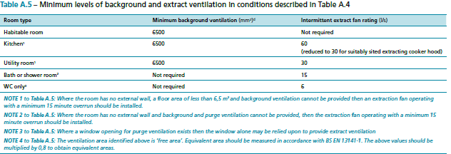
Changes to Ventilation requirement
A.5.3 Continuous Extract Ventilation
Evidence of condensation within the unimproved building, or the installation of measure(s) is intended to lower the air permeability of the building envelope below 5 m3/m2h @ 50 Pa (or is likely to do so) intermittent extract ventilation not sufficient.
Recommended that EEM include provision background ventilation as above combined with continuous extract ventilation from wet rooms (with intermittent boost). In these cases it is necessary that the provision of ventilation be consistent with the guidance and minimum levels of extract and supply ventilation specified in Table A.6.

Slide 81
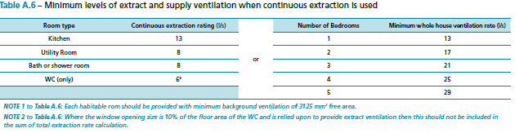
Changes to Ventilation requirement
Permitted Exclusions:
.5.4 Permitted exclusions
Where there is no evidence of condensation within the unimproved dwelling and it can be demonstrated by fan pressurisation testing in accordance with IS EN 13829:200 ‘Thermal performance of buildings: determination of air permeability of buildings: fan pressurisation method’ or ATTMA Technical Standard 1 ‘Measuring air permeability of building envelopes’ before and after the installation of measure(s), that the air permeability of the building envelope has not been lowered by the installation, then the existing ventilation need not be upgraded.
Similarly, if it can be demonstrated by one of the same methods, that the air permeability of the building envelope after the installation of measure(s) is not less than 5 m3/m2h @ 50 Pa then intermittent extract ventilation is acceptable and continuous extract ventilation need not be provided.
NOTE It is anticipated that during the lifetime of this edition of PAS 2030, new specifications and guidance on the provision and maintenance of appropriate ventilation in existing buildings, will be developed. Users of PAS 2030 are strongly encouraged to periodically check for updated information as to progress, with the BSI PAS 2030 web-pages.

Slide 82
Carding and sub contract labour
Increase in carding requirements for operatives
From 1 per site to 1 in 4 minimum and all supervisors
Use of unskilled non PAS complaint labour not acceptable
  6 Engagement of subcontract installers
“Where installer subcontracts any part of the installation to another installer by way of a subcontract, the installer shall include in the contractual requirement that the subcontractor complies with all requirements of this PAS that are relevant to the installation related tasks to be undertaken and ensure that the subcontractor has the necessary skills and competence for the installation tasks subcontracted.
The subcontracting installer shall retain responsibility for compliance with this PAS for all work subcontracted.”

Slide 83
New PAS2030Documentation
PAS2030 Measure Expert Group Annex B
Specification for the installation of external wall insulation ensuring the safety and operation of fuel burning appliances
External wall insulation pre-installation building inspection check list
Thermal Bridging Design Details

Slide 84
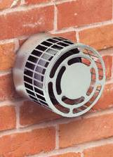
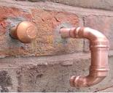
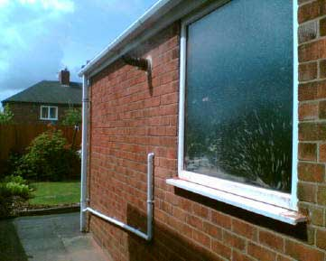
EWI ensuring safety and operation of fuel burning appliances
Started 3 years ago as a safety document
  Informs of risks, defines competency requirements,
  shows best/safe practice
  Pipe runs, ventilation, combustion ventilation,
  Flues, meter boxes
Debate on quality grew
  Thermal bridging importance
Avoidance of cold bridging
  Conflicts with accepted practice
Balance
  Ideal solution, achievable, affordable

Slide 85

EWI ensuring safety and operation of fuel burning appliances
Pragmatic approach
  Avoid cold bridges
  Adopt recognised principles where practicable
Onus of responsibility
  Installer
  Demonstrate all possibilities investigated and/or tried
Outcome
  Reduce risks to fuel burning installations as a result of EWI
  Remove the unintended negative consequences of EWI installation

Slide 86

Pre-Installation Check Sheet
Industry standard
  Maps questions that should have been answered in either
    EEM design
    Pre Building Survey
Go / No Go
    Checked at “first visit to site stage”
  Contractor should not move to installation without confirming all docs in place
Principle
  Provide consistent structure/format to identify most important information needed for EWI installs
  Reference back & check against the Building Survey
  Reference back & check against the system design

Slide 87
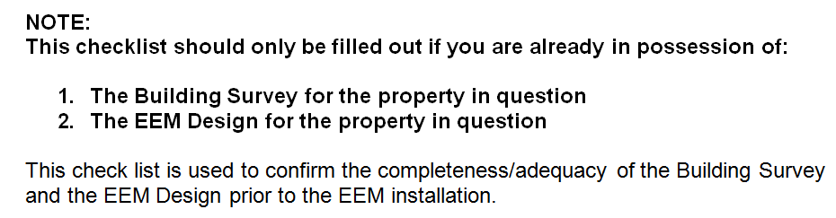

Pre-Installation Check Sheet
Example

Slide 88

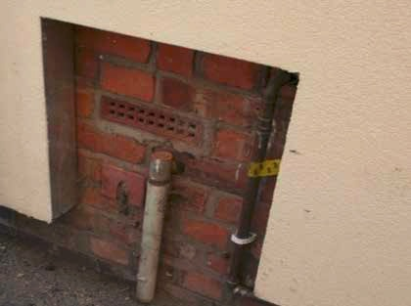
Cold Bridging design detail guide
Cold bridge areas do not “always” create issues
A combination of poor ventilation, “wet homes” and cold bridges will
SWIGA asked to look at damp issues through system regularly
SWIGA supports the cold bridge detail overview in PAS2030 2017
If you cannot find the detail you need – ask the system designer / system holder
Check existing ventilation and talk through need to ventilate when handing over
Always challenge the client on need to deal with cold bridging where possible
SWIGA happy to support with meetings / provide content to be used with clients
Most are localised cold bridging

Slide 89
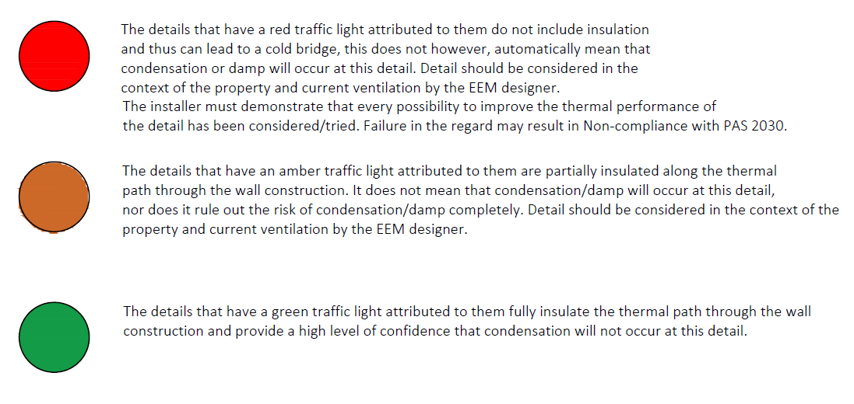
Thermal Bridging Design Details
A set of details to provide guidance for installers and designers
Assessed against a ‘Traffic Light’ key system.
The PAS asks for the best detail to be adopted ‘where practicable’ and a full assessment of all details undertaken to reduce the risk of cold bridging and possible condensation risk.
Installer responsibility to demonstrate all possibilities investigated and/or tried.
The details are not based on full assessment of building physics and all U-Values and Condensation risk assessment calculations should be carried out by the system designer to the guidance of BR443

Slide 90
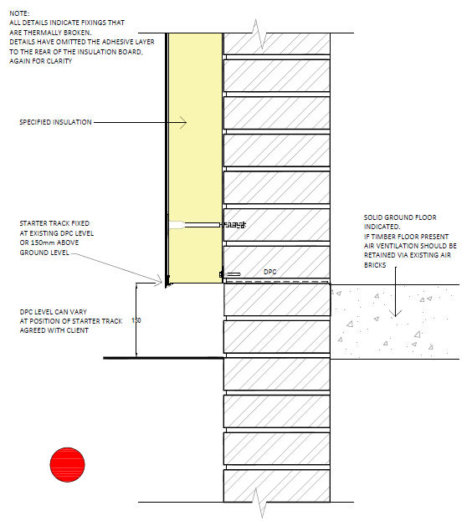
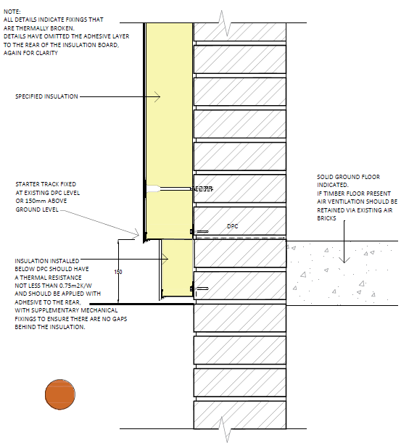
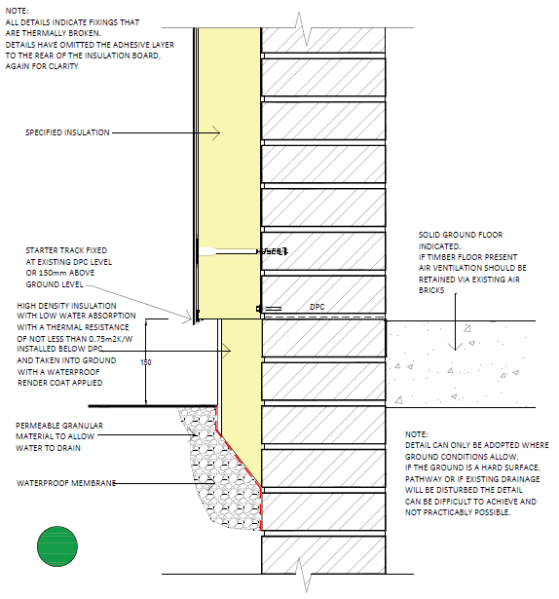
Thermal Bridging Design Details
In the main Standard details are covered. Project specific details should be discussed with the system designer and a detail provided.
The above details indicate typical examples showing 3 scenario’s for the same situation.
It is accepted that it is not always practicable to offer the ‘Green’ detail, but this should always be assess and if it is possible it should be discussed with the client.
They may choose to use the red option, however the assessment has been carried out and the ‘risks’ discussed.
The details are not mandatory however PAS 2030 puts more focus on improved standards and a greater level of assessment and control to ensure that Best Practice is provided.

Slide 91
Pas2031 Inspection rates
Current inspection rate for solid wall is 1%
Current timing left up to CB to decide
Government initially proposing move to 10% inspections for all solid wall measures
INCA (others) successfully argued to reduce this based on PAS quality inclusions
Reward good contractors by reducing inspection rate after 0 defect / 2 years

Slide 92
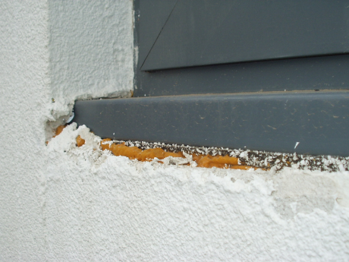
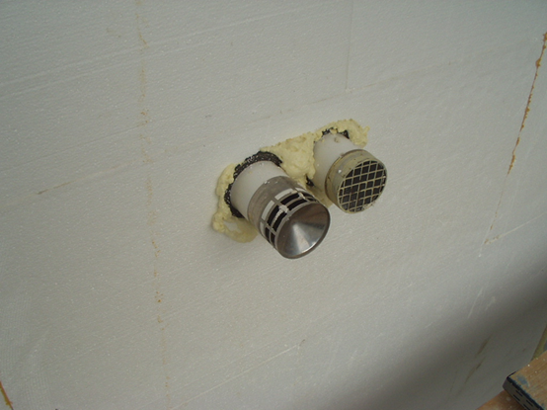
PAS 2030 ANNEX B summary
Measure specific considerations
  Exposure of site, suitability of structure, suitability of system, suitability of design details
Significant issues
    Avoidance of cold bridging/condensation
    Pre-installation survey check list go no go
    Ensuring safe use of fuel burning appliances
    Principles approach using industry standard details
  Avoidance of water entry
    Principles approach using industry standard details
    Double water barriers (non-reliance on just mastic sealant)
Outcomes
  Defined competencies
  More detailed and robust detailing for all
  Prevention of cutting corners
  More robust survey & installation requirements – consistent to all
  Cross-referenced to building survey and system design
  Greater number of checks at key times – good contractors rewarded

Slide 93
Questions

Slide 94
INCA Meeting for Members – 23 March 2017
INCA Awards 2017
Thursday 5 October
Industry Flagship Event of the Year
Mitch Gee
INCA Chairman
Notes:
Welcome everyone to this meeting for INCA members – great to see so many of you here
Key meeting today following the announcement of the proposed changes to ECO and I’m really pleased that Siobhan Stanger from DECC has joined us
We also have a really interesting session planned for after the coffee break where we want to hear your views on what INCA should be doing to help your business in 2014

Slide 95
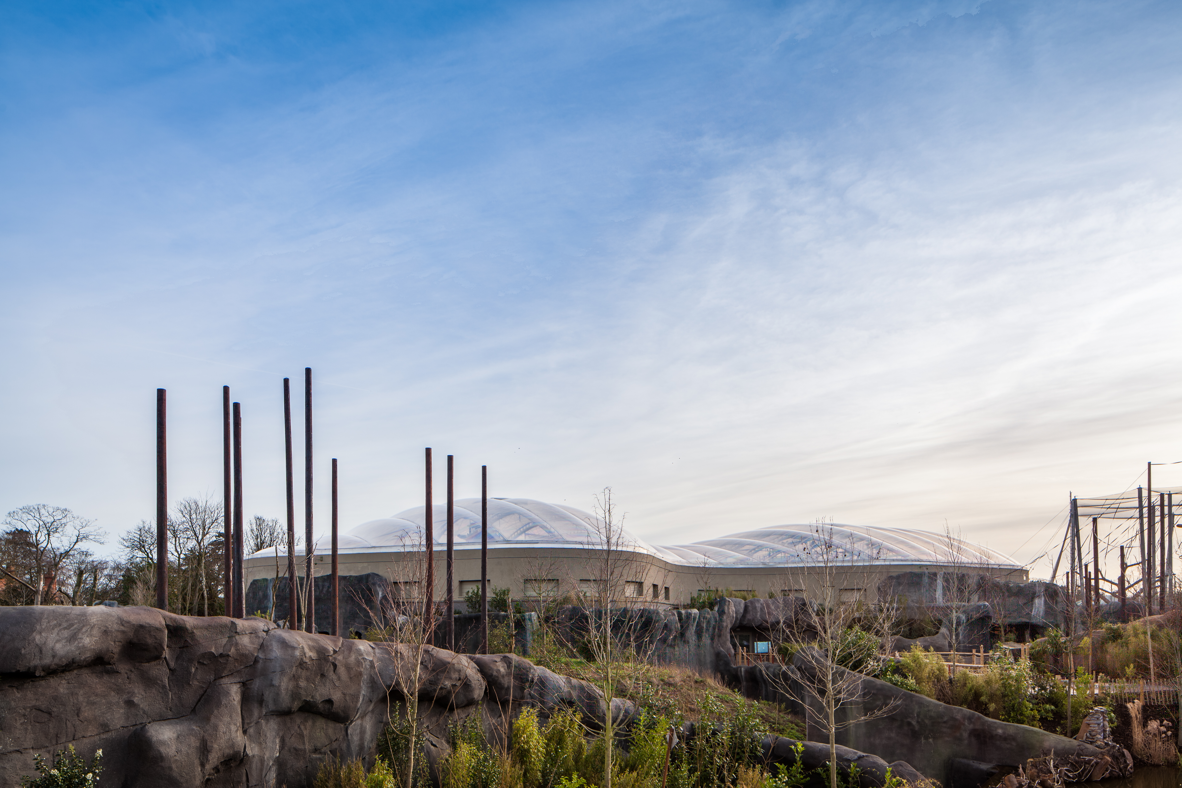
INCA Meeting for Members – 23 March 2017
INCA Awards 2017 – Thursday 5 October
Project categories:
New Build
Refurbishment
Alternative categories:
Architectural Design
Innovation
Environment
Training
Outstanding Achievement
Notes:
Welcome everyone to this meeting for INCA members – great to see so many of you here
Key meeting today following the announcement of the proposed changes to ECO and I’m really pleased that Siobhan Stanger from DECC has joined us
We also have a really interesting session planned for after the coffee break where we want to hear your views on what INCA should be doing to help your business in 2014

Slide 96

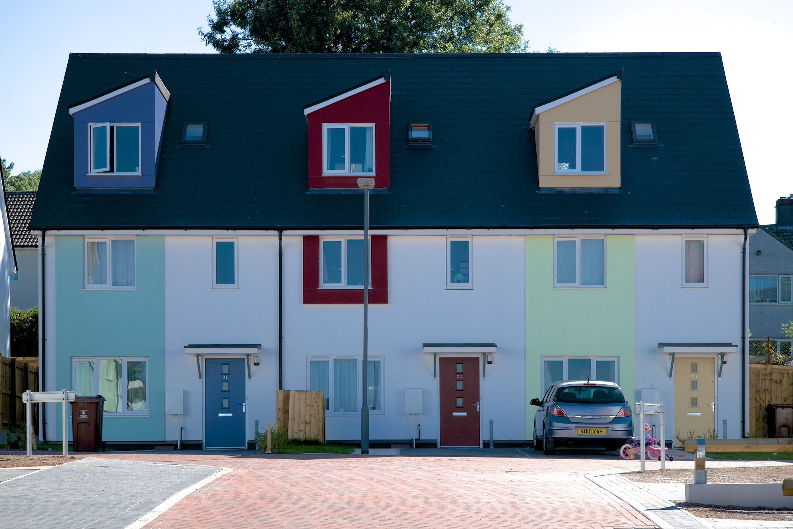
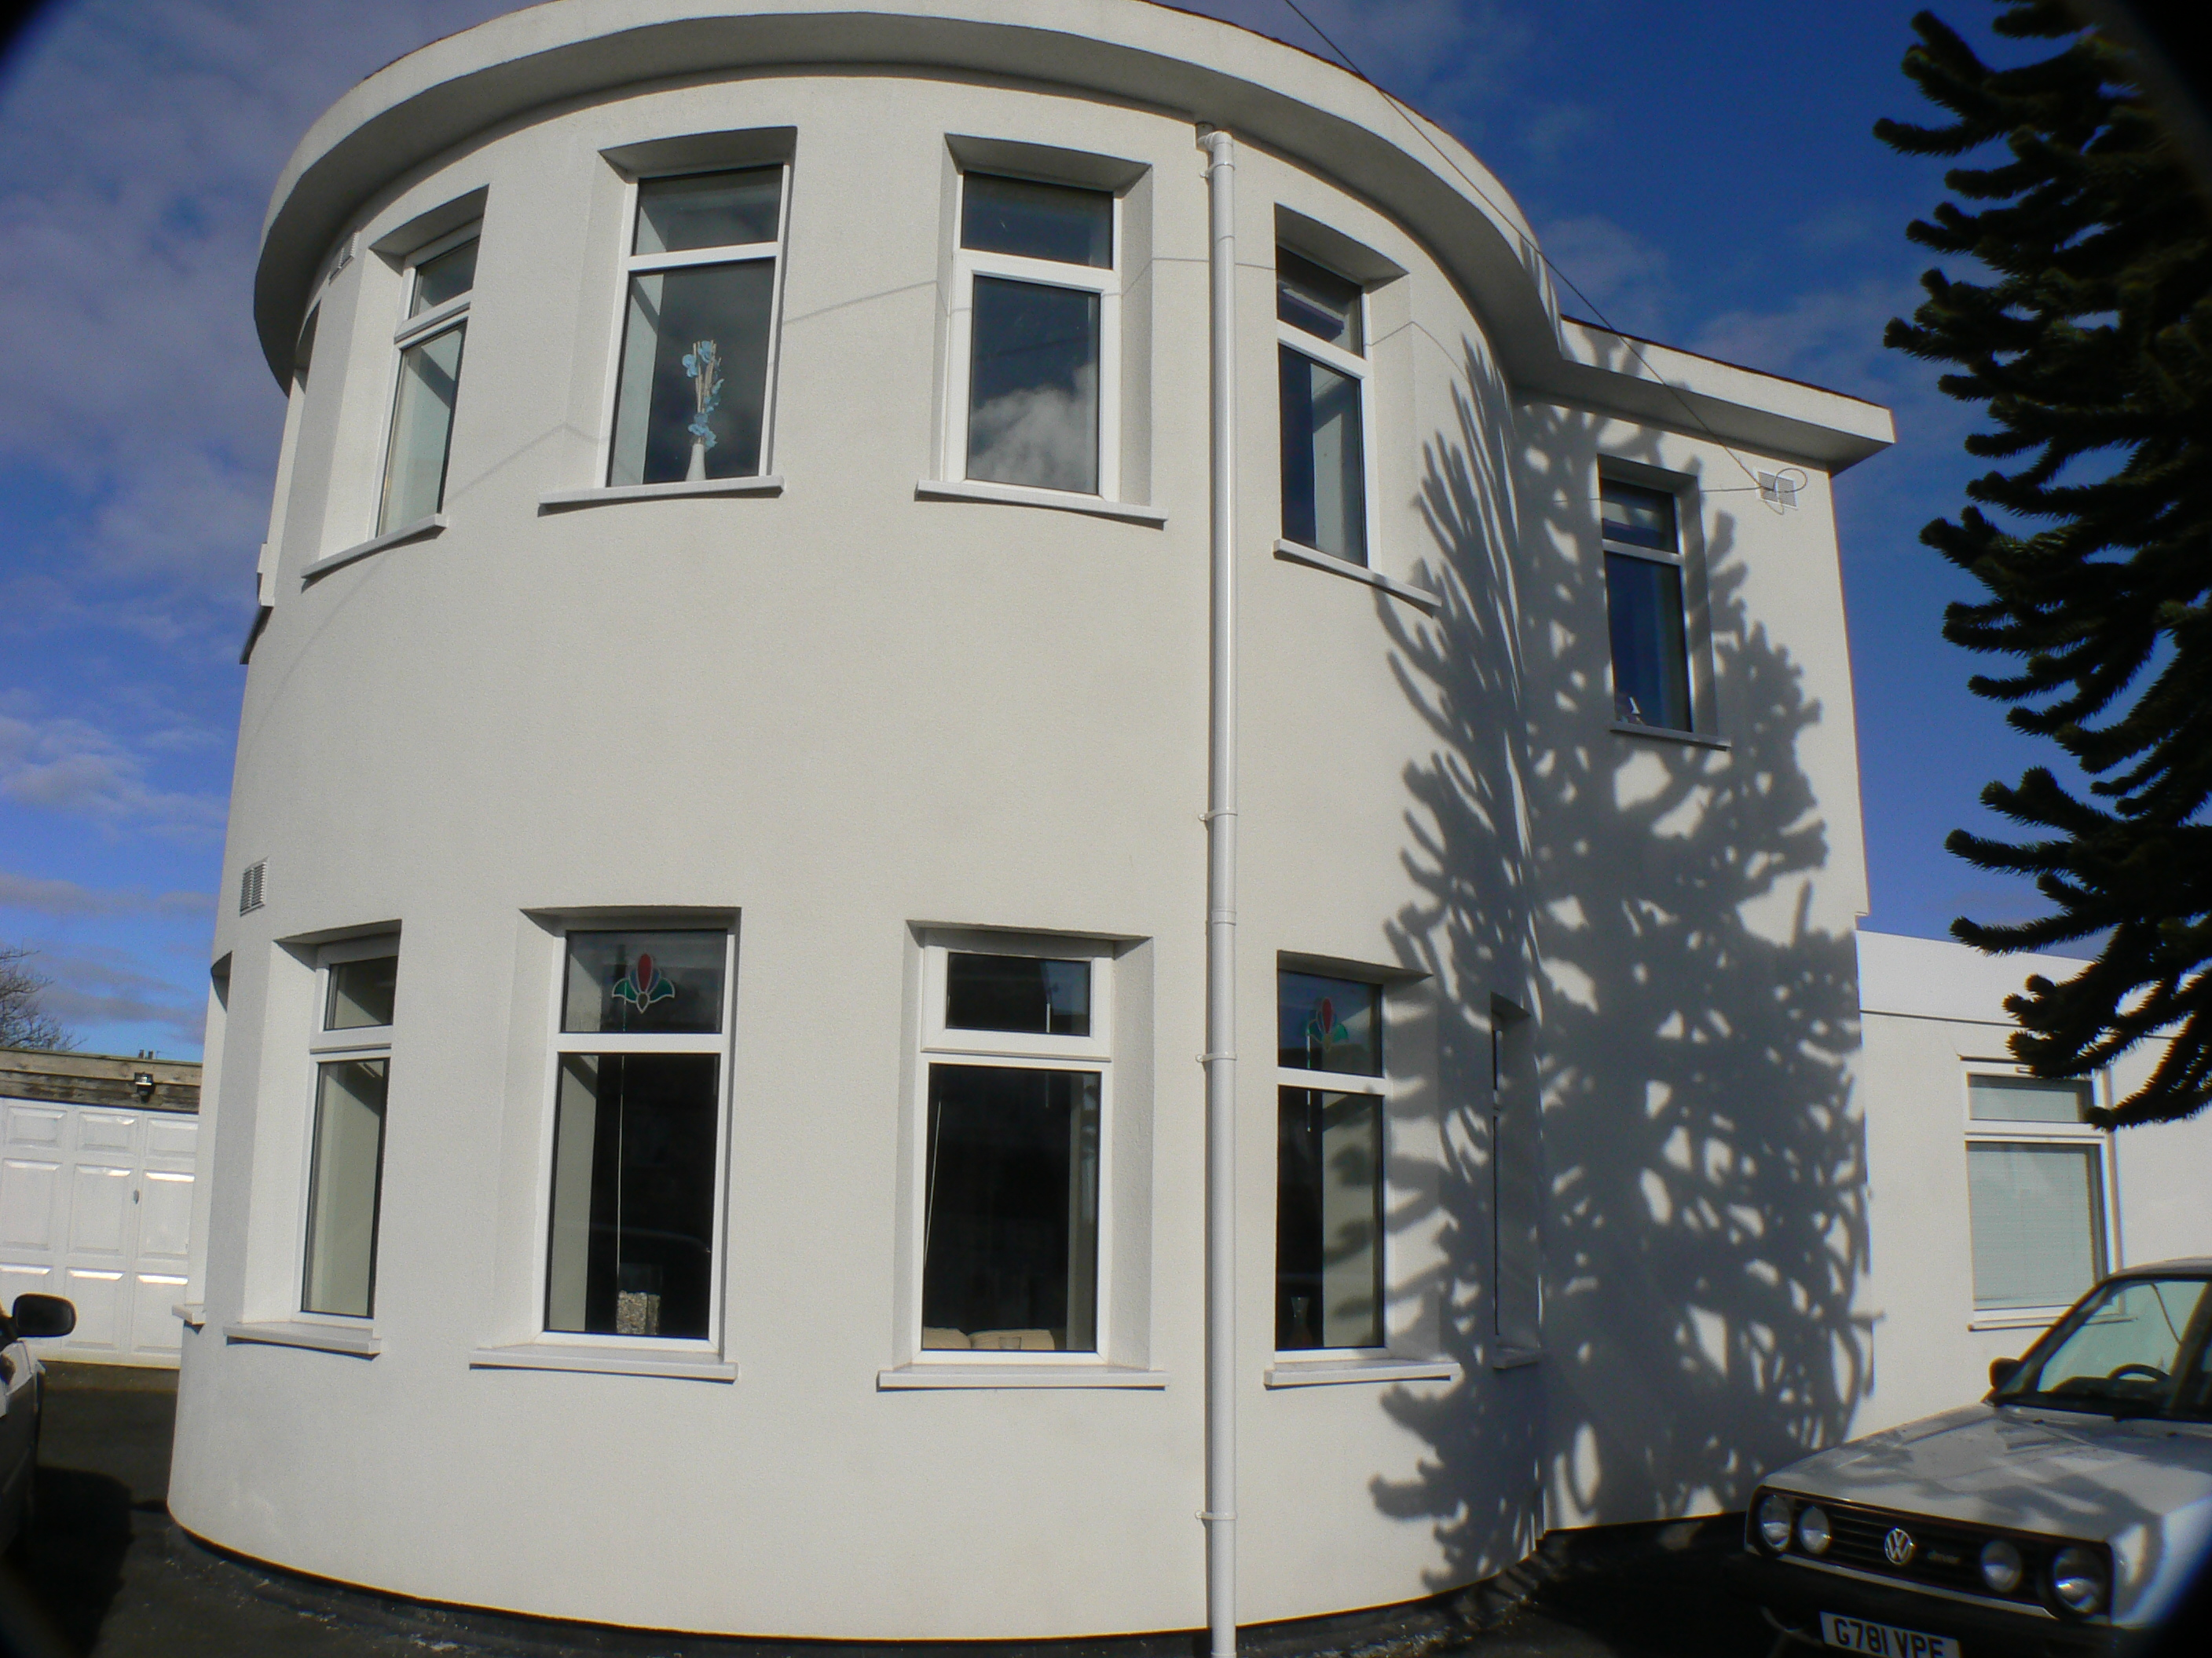
INCA Meeting for Members – 23 March 2017
INCA Awards 2017 – Thursday 5 October
New categories!
Small Installer of the Year
Large Installer of the Year

Slide 97
INCA Meeting for Members – 23 March 2017
INCA Awards 2017 – Thursday 5 October
Deadline Extended!
Friday 7 April
Enter, it could be you!

Slide 98
INCA Meeting for Members – 23 March 2017
Lunch & Networking
Blossoms Restaurant

Slide 99
INCA Meeting for Members – 23 March 2017
Ends

